Slide 1

CAR ACCIDENT SEVERITY PROJECT
Dhwanil shah

Slide 2
INTRODUCTION
This project is having large number of data about car accidents in particular region.
In this project we are doing operations on data and getting a conclusion in order to decrease car accidents.

Slide 3
OBJECTIVES
By doing this project we can easily predict the impact of different parameters on car accidents.
We analyze its relationships with various parameters and also done some predictions by which we can get proper conclusion.
We can also give various actions that government or public can take in order to downsize the number of accidents.

Slide 4
METHODOLOGY
Collect the data
Explore and Understand Data
Analyze the data
Modelling, Evaluation and testing

Slide 5
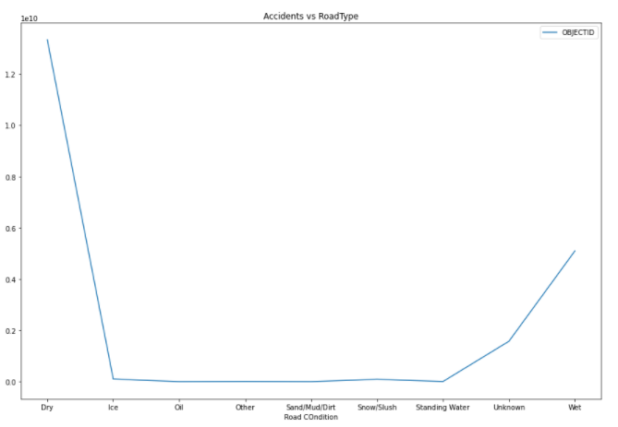
ACCIDENT AND ROAD CONDITION

Slide 6
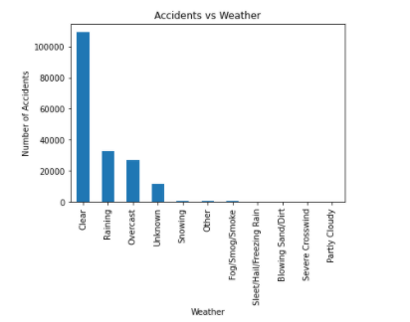
WHETHER AND ACCIDENTS

Slide 7
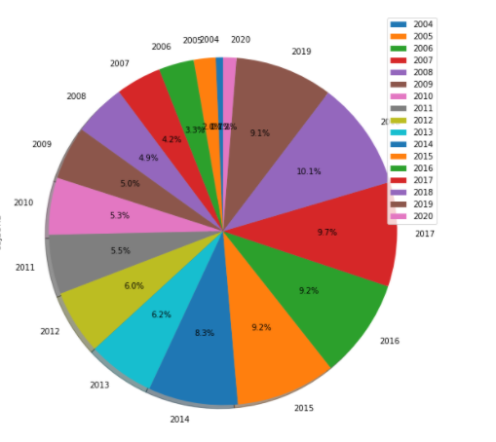
ACCIDENTS YEAR WISE

Slide 8
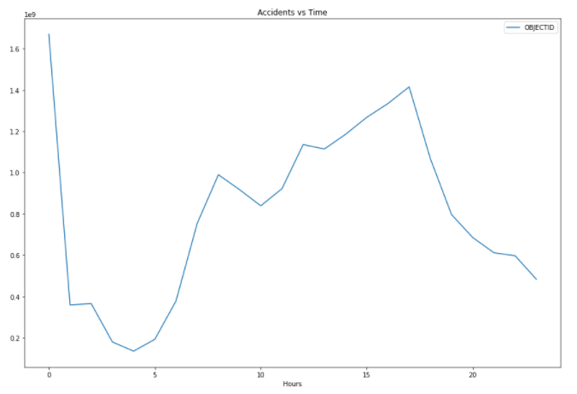
ACCIDENT AND TIME OF THE DAY

Slide 9
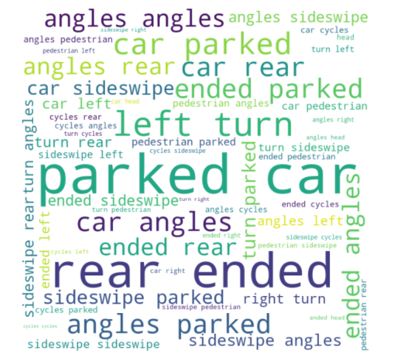
ACCIDENT AND COLISION TYPE
In this you can easily see that most of collisions are Parked car and rear ended collsions.

Slide 10
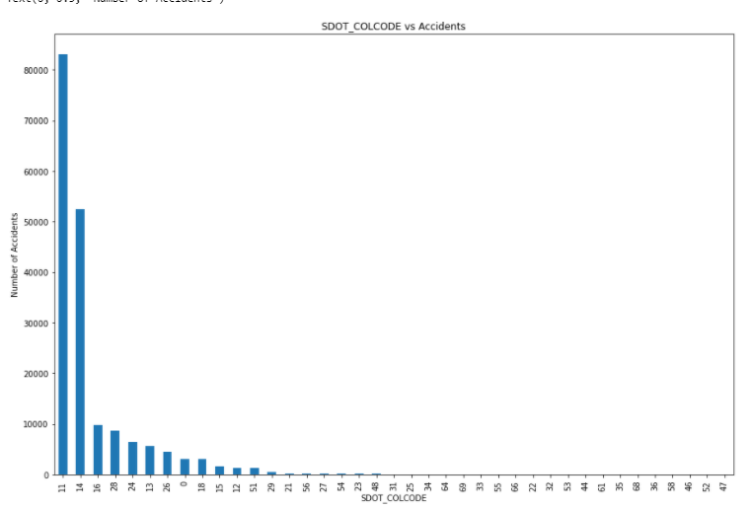
SDOT_COLCODE vs ACCIDENTS
I found it really interesting because if we control 11 and 14 then we can control 90% accidents.

Slide 11
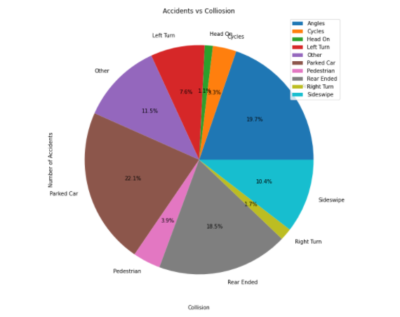
GRAPH FOR SDOT_COLCODE14
Most of the accidents are Parked Car and Angles for COLCODE 14.
Approx ¼ accidents are of parked car.

Slide 12
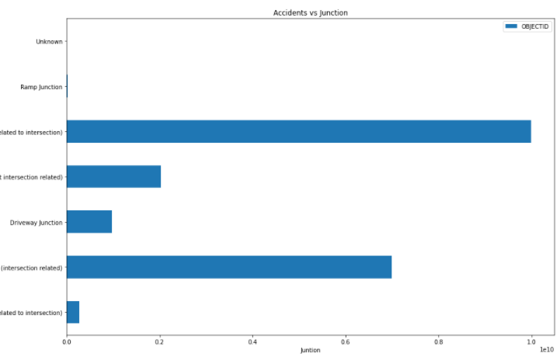
SDOT_COLCODE=14 ACCIDENTS Vs JUNCTION

Slide 13
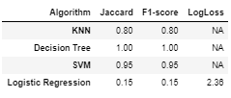
MACHINE LEARNING

Slide 14
CONCLUSION
At certain values of SDOT_COLCODE the accidents numbers are really high. We can eaily downsize it.
I can also say that weather condition, Light condition and road condition having less impact for road accidents. At certain timing the accidents are really high. Accidents with park vehicles are high and we can easily eradicate it.

Slide 15
FUTURE PREDICTION
Accidents on certain time is really high so we can easily deacrese it with the help of government and society. Accidents in last five years are really high as compare to previous 15 years. So we need to careful about it. Accidents with parked vehicles are really higher which can be easily decrease with the help of proper rules. Front end at angle and rear end are the reasons for most of accidents which can be easily downsize.

Slide 16
THANK YOU !!

